Slide 1

Information Article
APPLICATION TESTING AND METRIC
Teacher: Donald Coutts
Student : Kitman yiu

Slide 2
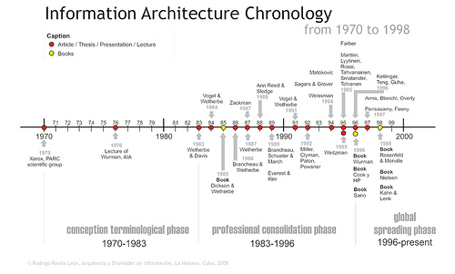
History

Slide 3
Definition
Different IS and IT
The structural design of shared information environments.
The art and science of organizing and labeling web sites, intranets, online communities, and software to support findability and usability.
An emerging community of practice focused on bringing principles of design and architecture to the digital landscape.
The combination of organization, labeling, search and navigation systems within websites and intranets.
Extracting required parameters/data of Engineering Designs in the process of creating a knowledge-based linking different systems and standards.
Hard

Slide 4
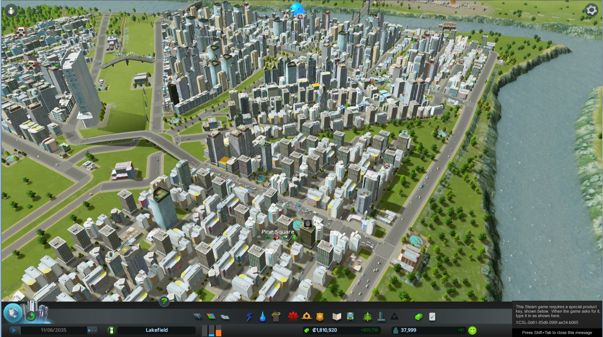
IA Purpose
Usability
Comprehensiveness
Relevance
Query performance

Slide 5

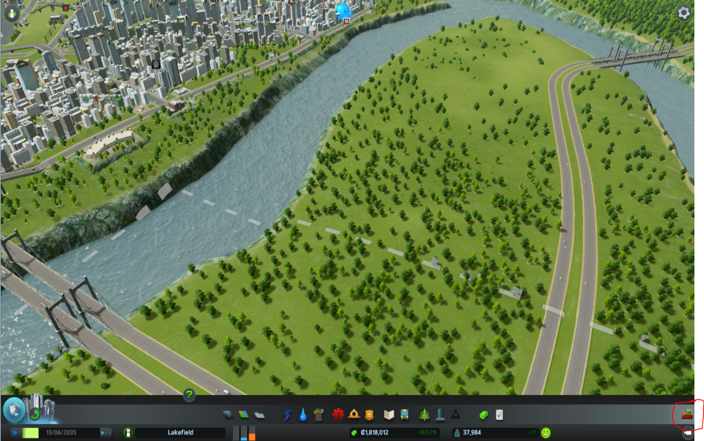
Examples

Slide 6
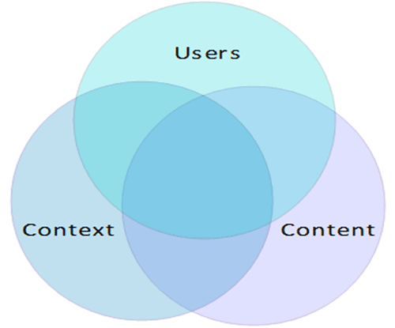
Components
Organization System
Labeling Systems
Navigation Systems
Search Systems
Venn diagram.
Context
Content
Users

Slide 7
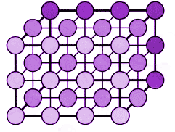
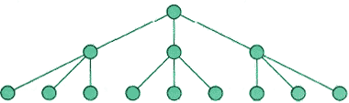
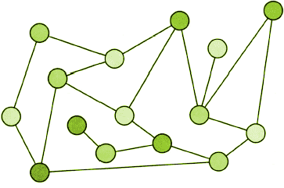
Components
Jesse James Garrett in the
"Elements of user experience: classification information about
the structure of the product user centered design“
and notice the following structure

Slide 8
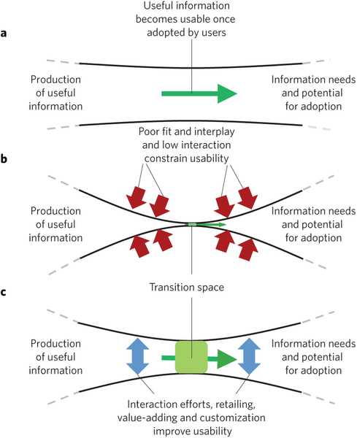
Web Usability Principle(WUP)

Slide 9
Definition of WUP
Web usability principles means:
Some rules that allow people to
Learnability
Efficiency
Memorability
Errors
Satisfaction
, in the web

Slide 10
Goal of WUP
Save user’s time by making everything clear, easy and accessible.
Increase satisfaction from the website experience and prevent negative response.

Slide 11
Components
USABILITY MEANS…
WEB APPLICATIONS SHOULD EXPLAIN THEMSELVES.
DON’T MAKE ME THINK
DON’T WASTE MY TIME
USERS STILL CLING TO THEIR BACK BUTTONS
WE’RE CREATURES OF HABIT
NO TIME FOR SMALL TALK
DON’T LOSE SEARCH
WE FORM MENTAL SITE-MAPS
MAKE IT EASY TO GO HOME

Slide 12
Components 1
Visibility of system status
Match between system and the real world
User control and freedom
Consistency and standards
Error prevention
Recognition rather than recall
Flexibility and efficiency of use
Aesthetic and minimalist design
Help users recognize, diagnose, and recover from errors
Help and documentation

Slide 13
Components 2
Hallway testing
Remote Usability Testing
Expert review
Automated expert review
A/B testing

Slide 14
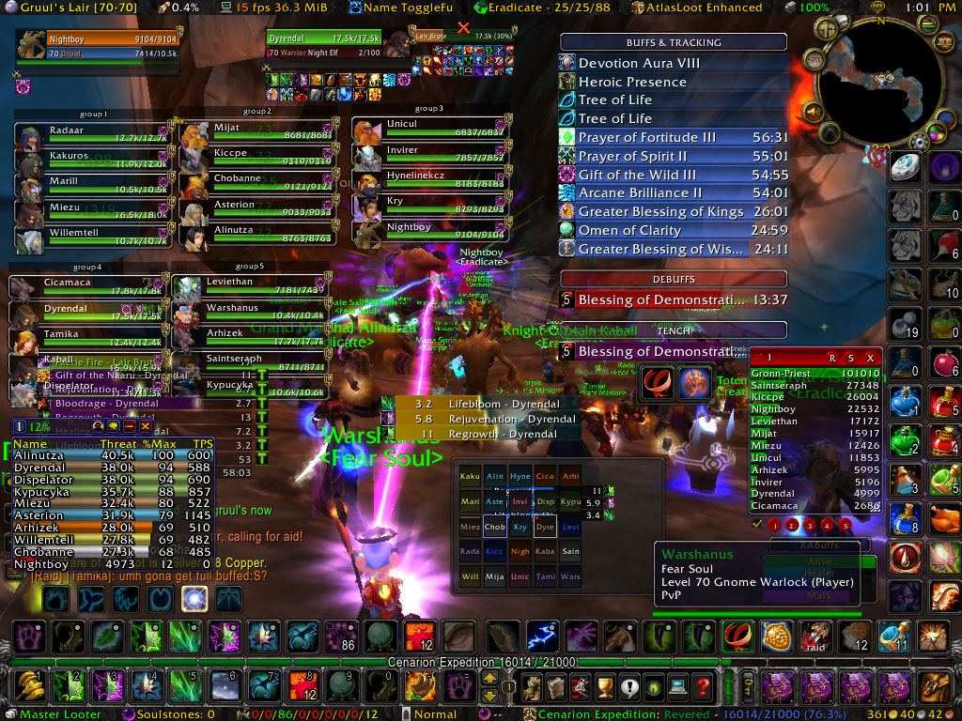
A example of apply to game

Slide 15
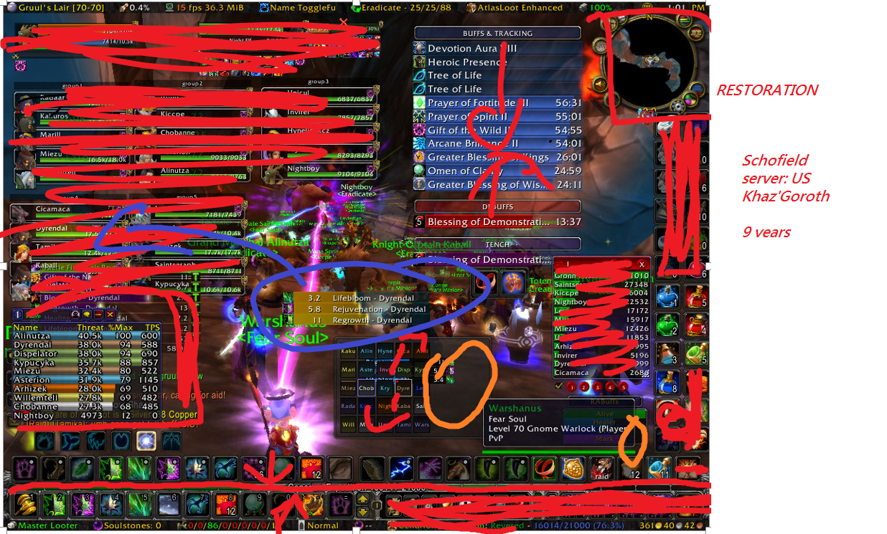

Slide 16
IA and Game
GOAL comprehensiveness, usability, relevance and query performance
comprehensiveness information (eg: enemy health, teammate’s health, chatting information ….. )
usability information, because some of the information are unless for example: other teammates health is unless in a battle
relevance information as a beginner there is no way to know what information are useful and what are not
query performance it is terrible, because there are too much information, which even the information are overlapped in the game.

Slide 17
WUP and Game
Following by the rules from Steve Krug’s these rules
USABILITY MEANS… | WEB APPLICATIONS SHOULD EXPLAIN THEMSELVES. | DON’T MAKE ME THINK | DON’T WASTE MY TIME
This can same to same. | Player should after clicking all the action the player should know what they are doing | Players don’t want to think where the buttons , so limit maybe 3 click to the task we be good | Always allow people to find information easily of they forget some stuff
WE’RE CREATURES OF HABIT | DON’T LOSE SEARCH | WE FORM MENTAL SITE-MAPS | MAKE IT EASY TO GO HOME
We make things that the user can use it again and again so it will be a habit | It should allow us easily switch between the game scene and the menu scene | User can remember after clicking a button where does it go | The user should be able to go back to the main menu easily by clicking not more than 2 buttons
USERS STILL CLING TO THEIR BACK BUTTONS | NO TIME FOR SMALL TALK
No back button in game | Different players and different game have different task some case there need to be a small talk about the game.

Slide 18
WUP and Game
Visibility of system status | User Control and freedom | Consistency and standards
User should be able to recognize what buttons are able to click and what are not The system should have different images after the button is click | If the user click open some panel there are a X button of the right hand side of the Conner to close the window | Symbols should related to the image that what action they are doing.
Error prevention | Recognition rather than recall: | Asthetic and minimalist design
This rule can be … in game , since pressing the wrong button doesn’t effect a lot | Once you look at image the player should already recognize what is it about | Only shows the information are need in the game The most important information should be bigger and the less important information should be smaller
Help users recongnize , and recover from errrors | Help and documentation: | Match between system and the real world
After the user click the wrong button it should allow us to go to a panel which allow us to click the right button | If there are more than 15 buttons that the user will always click , they should create an online document Game tutorials should be showed up in the game menu which Tutorials can be either No tips , one tips, and always have tips | The words in the game should matches the game which are similar to other type of games User should know what state are they in (eg : battle state , idle state) If no similar game was exists, make sure user can understand the word by doing a action.
Flexibility and efficiency of use
The game should both have shortcuts and buttons

Slide 19
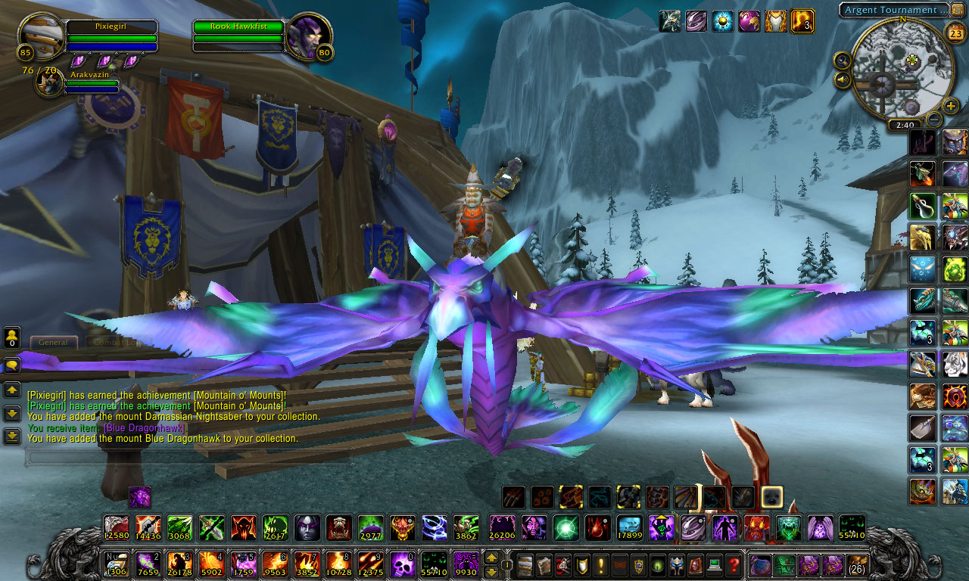
Redesign

Slide 20
Test
Hallway testing
Remote Usability Testing
Expert review
Automated expert review
A/B testing

Slide 21
Conclusion
We can apply some WUP to game
We can apply some IA to game
Need more research

Slide 22
End

